Slide 1



Slide 2
The Data
The Most Recent Employee Benefit Statistics
49%
51%
64%
78%
49% of employees will leave their job in the next 12 months over a lack of benefits.*
51% of employees say benefits will play a significant role in talent retention.*
64% of employees believe their generation is likely to be much worse off in retirement than that of their parents.*
78% of employees say they would stay with a company because they like the benefits.*
*Data provided by Willis Towers Watson (NASDAQ: WLTW) and TeamStage

Slide 3
How Can The Geneva Affinity Mortgage Program Benefit Your Employees?
Zero Cost To You
Dedicated Representative
Homebuyer Education
Savings
This benefit costs you ZERO dollars to offer to your workforce.
Your employees would have ONE dedicated Geneva Licensed Loan Officer representing them.
We will educate your workforce on the financial and emotional benefits of owning a home, and home financing strategies.
By utilizing Geneva AMP, your employees will receive an exclusive lender credit.
We will work closely with the appropriate teams to curate the material you need to spread awareness of this incredible program to your workforce in a way that works best for your company.

Slide 4

About Geneva Financial
Founded in 2007 by Aaron VanTrojen, Geneva Financial NMLS 42056
Top Ranked direct mortgage lender headquartered in Chandler, Arizona
More than 100 locations nationwide
Licensed in 46 States
We have one of the most expansive loan product offerings in the industry.
Our #1 Core Value is the backbone of all our core Values, our mission and our brand vision: Home Loans Powered by Humans®.

Slide 5
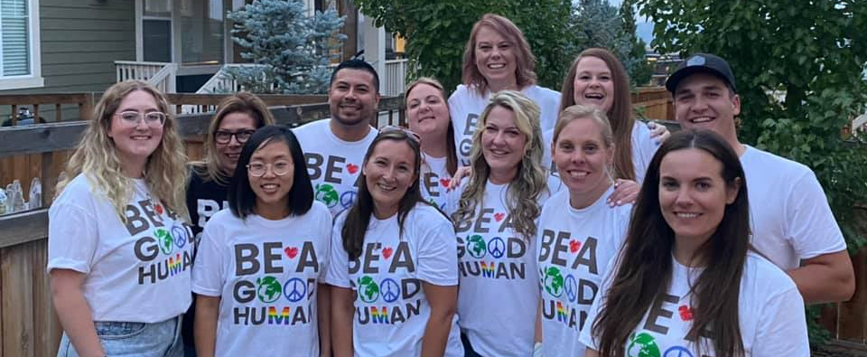
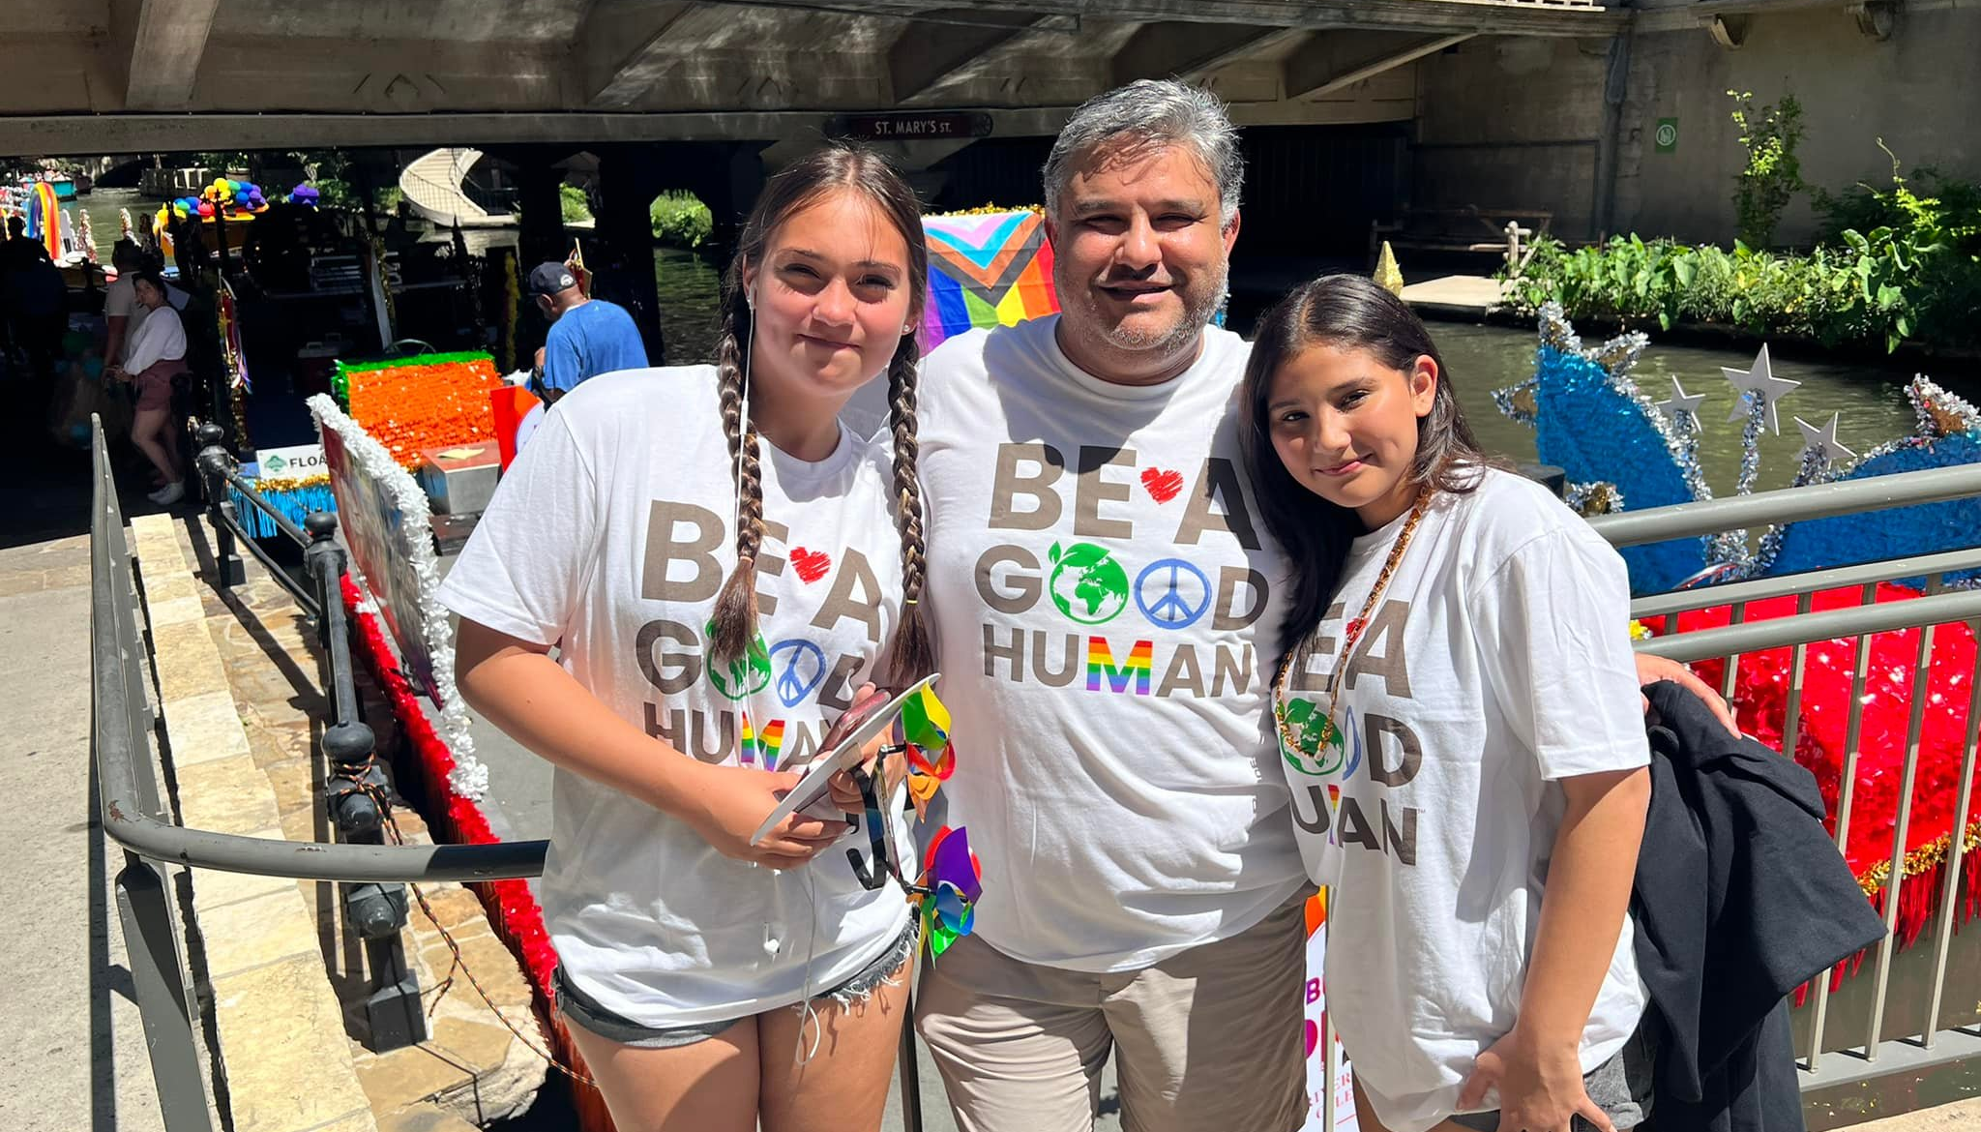

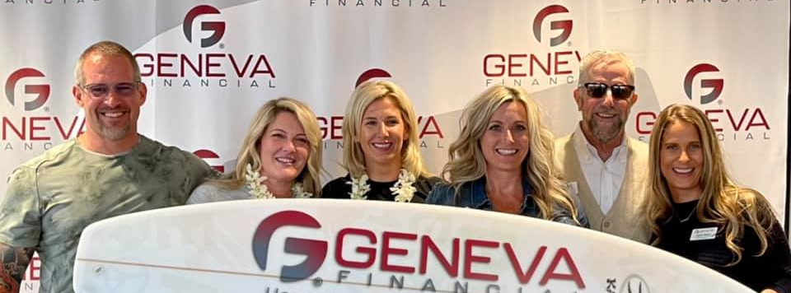
Whether in the office or off the clock, everyone at Geneva believes in the importance of giving back and sharing real-life examples of kindness with the people around us. This is our way to continue spreading the message and encourage people to make change in their communities.
Geneva’s BE A GOOD HUMAN initiative has provided grants and support for multiple charitable organizations including Autism Speaks, Beat Street AZ, Cloud Covered Streets, RV’s For MD’s and others.
We are always looking for incredible charities and causes to support. Let us know if we can help you help the communities you serve!

